Slide 1
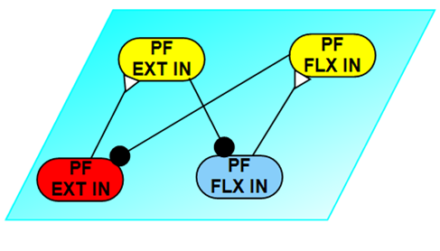
Simple basic CPG model
The basic CPG model which contains 4 neuron nodes: Ext; Flex; Ext In; Flex In. The stimulus are all 2nA @ 2 s to 2.5 s.
Left top: not stimulus. Left medium: excite Ext node. Left bottom: inhibit Ext node.
Right top: excite both Ext and Flex. Right medium: excite Ext but inhibit Flex. Right bottom: inhibit both Ext and Flex.

Slide 2
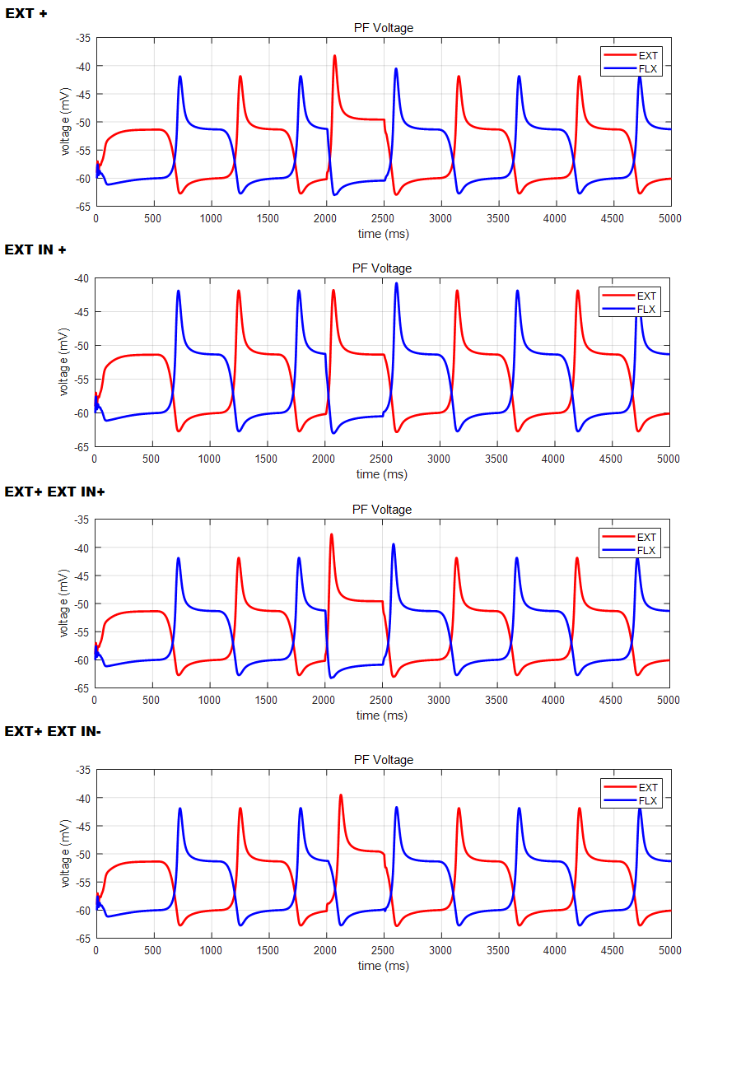
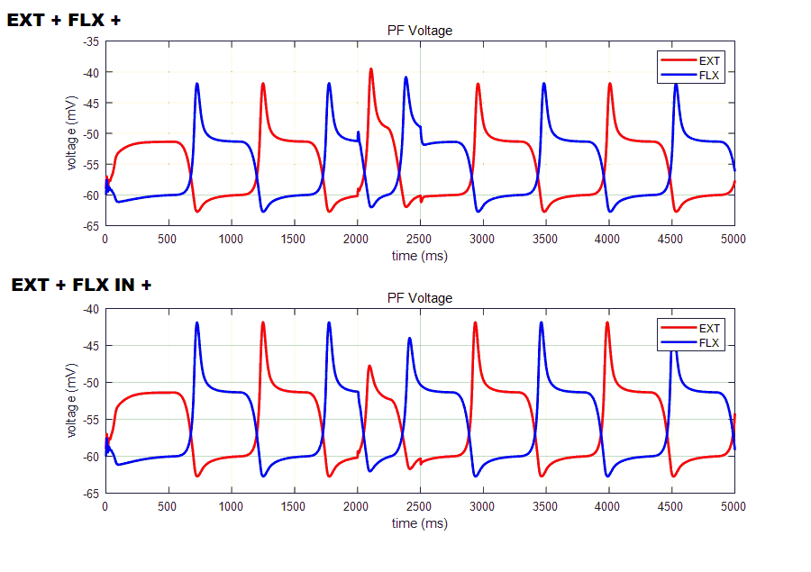
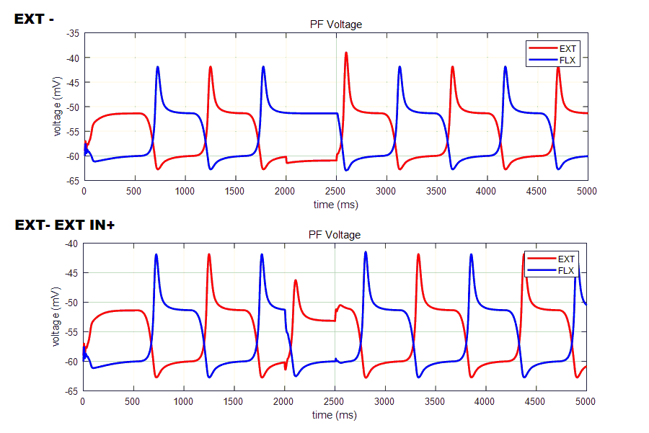
Stimulus acting on same side of nodes works the same, but acting on In make the shape more smooth. Acting both not change shape a lot instead just increase amplitude slightly.
Normally, CPG are more dominant by the pattern formation nodes than the interneurons. But there is one exception, which is CPG is more sensitive on excitatory stimulus than inhibitory ones.

Slide 3
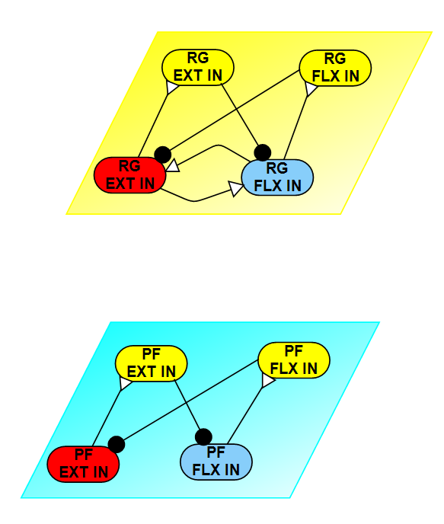
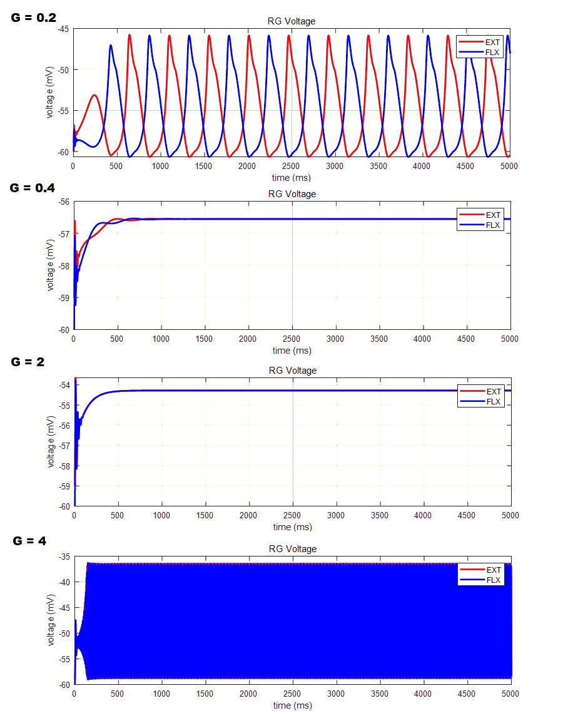
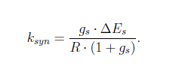
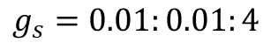
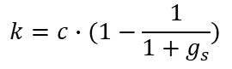
RG of the CPG model
The rhythm generator model is pretty similar as the pattern formation layer, except there is a reciprocal week excitation between the EXT and FLX neuron nodes. We choose to use synaptic conductance of 0.05 instead of 2 which we use in the PF model.
How the week excitatory synapse conductance value vs the oscillation period.
$$g_{s}=0.01:0.01:4$$
$$k=c∙(1−\frac{1}{1+g_{s}})$$
As other synaptic variables are the same, the synaptic transmit ratio is positively correlated with the conductance value.
0.3
We also investigate what is the limit of the week excitatory synapse conductance value to stop making the RG oscillating.
It turns out that when conductance is higher than 0.25 it starts to loosing shape. Thus, 0.25 is the maximum conductance we could go.
0.25

Slide 4
Gs = 0.25, last conductance to keep shape
0.3
Gs = 0.3, expanding wave
0.25
Gs = 0.32, expanding wave, but still oscillating
Gs = 0.33, wave shrinking, but still oscillating

Slide 5
Two-layer CPG model
The stimulus are same as previous all 2nA @ 2 s to 2.5 s.
The simple two-layer CPG have 8 neurons and 12 synapse.
Two-Layer CPG oscillation, with no external stimulus.
When Excite the RG EXT, changed rhythm.
When Excite the PF EXT, rhythm not affected.
When Excite the PF EXT, with stronger stimulus, shape change tremendously, rhythm still not affected.
When Excite the RG EXT, but inhibit PF EXT with stronger stimulus. Shape changed, rhythm not affected.

Slide 6
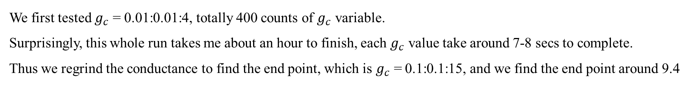
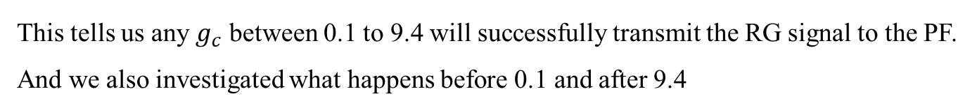
How conductance of RG->PF synapse affects PF rhythm?
We first tested $g_{c}$ = 0.01:0.01:4, totally 400 counts of $g_{c}$ variable.
Surprisingly, this whole run takes me about an hour to finish, each $g_{c}$ value take around 7-8 secs to complete.
Thus we regrind the conductance to find the end point, which is $g_{c}$ = 0.1:0.1:15, and we find the end point around 9.4
~9.4
<0.1
This tells us any $g_{c}$ between 0.1 to 9.4 will successfully transmit the RG signal to the PF.
And we also investigated what happens before 0.1 and after 9.4

Slide 7
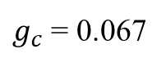
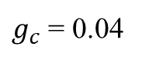
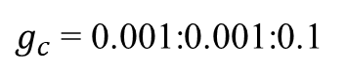
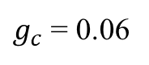
$g_{c}$ = 0.001:0.001:0.1
$g_{c}$ = 0.04
0.067
0.049
$g_{c}$ = 0.06
$g_{c}$ = 0.067

Slide 8
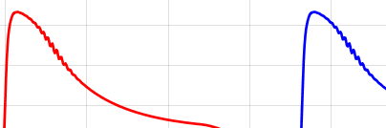
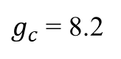
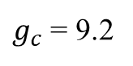
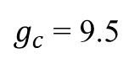
What happens when conductance lager than 9.4?
~9.4
$g_{c}$ = 9.5
$g_{c}$ = 9.2
$g_{c}$ = 8.2

Slide 9
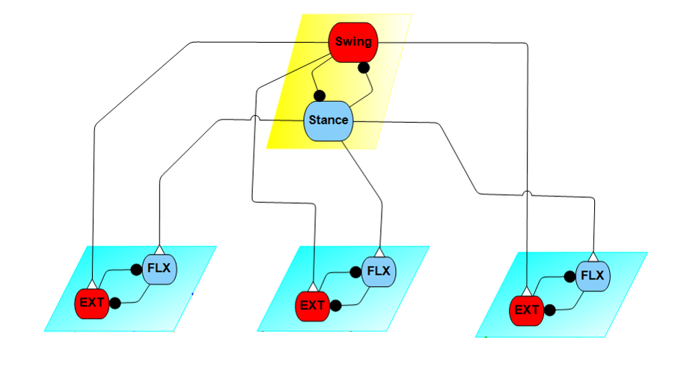
Two-layer Leg CPG
Rhythm generator at top, transmit periodic signal to pattern formation layer to operate. Each individual PF layer works isolated and do not talk to each other.
In the bottom left figure, there is no stimulus to the whole configure, thus the three PF waveform is the same.
In the bottom right figure, no stim on Hip, 4nA @ 1-1.5 s to the Knee Ext, -8 nA @ 2-3.5 s to both Ankle EXT & FLX. We can see the stimulus on one layer does not interrupt other layer, and the rhythm always resume.

Slide 10
What is the improvement of Leg-CPG than previous Two-layer CPG model?
The new code is not just adding 2 more pattern formation layer which is 8 more neurons and 10 more synapse.
Instead, I put these neurons into individual subnetwork, and recruit them.
Previous:
Now:
To construct an CPG, we need manually input a lot:
N*13 neuron properties
N*6 neuron initial states
S*4 synapse properties
S*3 synapse initial states
Most annoying connective map as shown below:
To construct an CPG, we just give inputs and recruit the subnetwork script we wrote and it automatically generate the CPG.
NO more manual input properties. NO more messy connective map.
N : number of neurons
S: Number of synapses
One more benefit:
As I showed in previous slides. If we want to test how an synapse parameter affects the network. It took about 7-8 seconds per value and for a 400 count value set, it took around an hour to finish. Which is ridiculous and unacceptable.
In this new module CPG codes. As we don’t need to calculate 4 RG nodes again and again, we just run one time and record the two nodes value, make them as inputs of PF module.
Also as its module we can run parfor now, the run time reduced to 17 seconds for same 400 count value set !

Slide 11
What I’m doing and expect to achieve?
Now, the RG and PF module is in function form, I’m working on transmit it into objective function form. Which give me the ability to connect to the work I done before and give it the opportunity to handle it in future optimization.
Also, after I transform it into objective function form. I could use the parameters and feedbacks in previous published work to do sanity checks.
Fletcher has sent me some EMG data from Dr. Tresch, that is the next focus which helps me tuning the feedbacks for the biarticular muscle models.

